Slide 1
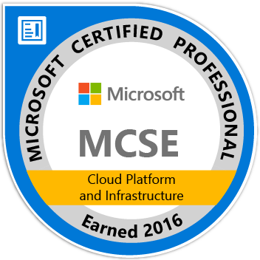
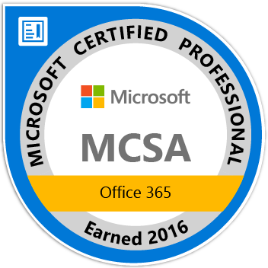
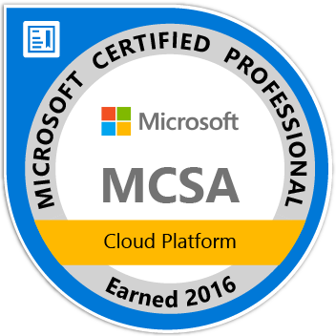

Design Application Storage and Data Access Strategy
https://www.kloudezy.com
Niraj Kumar
Lead Azure Architect-EY, MCT(Microsoft Certified Trainer)
AzureTalk community group moderator, http://azuretalk.kloudezy.com
http://linkedin.kloudezy.com

Slide 2
Design Application Storage and Data Access Strategy
Design Data Storage Options
Design Data Storage Security
Security Options For Perf
Storage for Cloud & Hybrid

Slide 3
Let’s Play
Game Time

Slide 4
Exam 70-534 Architecting Microsoft Azure Solutions
#1 Design Azure Resource Manager (ARM) networking (5–10%)
Design Azure virtual networks - Extend on-premises
Describe Azure VPN and Express Route architecture and design
#2 Secure resources (20–25%)
Secure resources by using managed identities
Identify an appropriate data security solution
Design a role-based access control (RBAC) strategy
Manage security risks by using an appropriate security solution
#3 Design an application storage and data access strategy (5–10%)
Design data storage
Select the appropriate storage option
#4 Design advanced applications (20–25%)
Create compute-intensive applications
Create long-running applications
Integrate Azure services in a solution
Implement messaging applications
Implement applications for background processing
Design connectivity for hybrid applications
#5 Design Azure Web and Mobile Apps (5–10%)
Design Web Applications
Design Mobile Applications
#6 Design a management, monitoring, and business continuity strategy (20–25%)
Design a monitoring strategy
Describe Azure business continuity/disaster recovery (BC/DR) capabilities
Design a disaster recovery strategy
Design Azure Automation and PowerShell workflows
Describe the use cases for Azure Automation configuration
#7 Architect an Azure Compute infrastructure (10–15%)
Design ARM Virtual Machines (VMs)
Design ARM template deployment
Design for availability
+ Bonus: Containers
https://www.microsoft.com/learning/en-us/exam-70-534.aspx

Slide 5
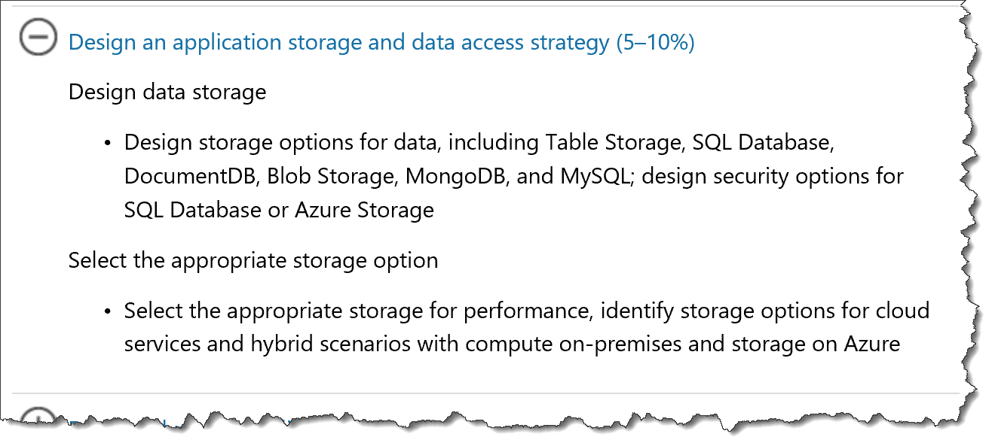
Storage in 70-534
https://www.microsoft.com/en-us/learning/exam-70-534.aspx

Slide 6
Storage in 70-534(Azure)
Products
Table Storage
Blob Storage
SQL Database
CosmosDB (old name DocumentDB)
MongoDB
MySQL
Security Options
SQL Database
Azure Storage
Performance
Hybrid scenarios

Slide 7
Design Data Storage Options
Table Storage
NoSQL
Azure SQL Database
Relational
Tables
MySQL
Relational
Fast DB
Key/attribute
Schemaless
Fast Data Access
Relatively inexpensive
FK, PK, Indexes, etc.
Open Source
CosmosDB
NoSQL
JSON / JavaScript
Blob Storage
Unstructured data
Disks, Images, Logs
MongoDB
NoSQL
JSON-like
Dynamic schemas
High performance
Data Security Options
Azure Storage | Share Access Signature - SAS
Azure SQL Database – same model as on-premises
See aka.ms/azure/storage for a complete introduction
Microsoft Azure Storage Explorer is a standalone app from Microsoft that allows you to easily work with Azure Storage data on Windows, macOS and Linux. http://storageexplorer.com/
Source: Mark Grimes https://mva.microsoft.com/en-US/training-courses/certification-exam-overview-70534-architecting-microsoft-azure-solutions-17406?l=olgrYVmjD_6006218965
Notes:
Design an application storage and data access strategy (15–20%)
Design data storage
Table Storage
With a schemaless data store, it's easy to adapt your data as the needs of your application evolve. Table storage is easy to use, so developers can create applications quickly. Access to data is fast and cost-effective for all kinds of applications.
Table storage is typically significantly lower in cost than traditional SQL for similar volumes of data.
SQL Database, DocumentDB, Blob Storage, MongoDB, and MySQL
design security options for SQL Database or Azure Storage; identify the appropriate VM type and size for a solution
MySQL” is “My Ess Que Ell” (not “my sequel”),
http://azure.microsoft.com/en-us/documentation/articles/storage-introduction/
http://azure.microsoft.com/en-us/marketplace/partners/mongodb/mongodb-inc/
DocumentDB Azure DocumentDB is a NoSQL document database service designed from the ground up to natively support JSON and JavaScript directly inside the database engine. It’s the right solution for web and mobile applications when predictable throughput, low latency, and flexible query are key. Microsoft consumer applications like OneNote already use DocumentDB in production to support millions of users. http://azure.microsoft.com/en-us/services/documentdb/
4 NoSQL options…
Graph Database
Cp;umn-Family?????????
Document
Key/Value
http://www.asp.net/aspnet/overview/developing-apps-with-windows-azure/building-real-world-cloud-apps-with-windows-azure/data-storage-options
Compared to relational databases, the NoSQL options offer far greater scalability and cost-effectiveness for storage and analysis of unstructured data. The tradeoff is that they don't provide the rich queryability and robust data integrity capabilities of relational databases. NoSQL would work well for IIS log data, which
h involves high volume with no need for join queries. NoSQL would not work so well for banking transactions, which requires absolute data integrity and involves many relationships to other account-related data.
There is also a newer category of database platform called NewSQL that combines the scalability of a NoSQL database with the queryability and transactional integrity of a relational database. NewSQL databases are designed for distributed storage and query processing, which is often hard to implement in "OldSQL" databases. NuoDB is an example of a NewSQL database that can be used on Azure.
A shared access signature provides delegated access to resources in your storage account. This means that you can grant a client limited permissions to your blobs, queues, or tables for a specified period of time and with a specified set of permissions, without having to share your account access keys. The SAS is a URI that encompasses in its query parameters all of the information necessary for authenticated access to a storage resource. To access storage resources with the SAS, the client only needs to pass in the SAS to the appropriate constructor or method.
You can use a SAS when you want to provide access to resources in your storage account to a client that can't be trusted with the account key. Your storage account keys include both a primary and secondary key, both of which grant administrative access to your account and all of the resources in it. Exposing either of your account keys opens your account to the possibility of malicious or negligent use. Shared access signatures provide a safe alternative that allows other clients to read, write, and delete
Security administration in Microsoft Azure SQL Database is similar to security administration for an on-premises instance of SQL Server. Managing security at the database-level is almost identical, with differences only in the parameters available. Because Azure SQL Databases can scale to one or more physical computers, Microsoft Azure SQL Database uses a different strategy for server-level administration.

Slide 8
Design Data Storage Options
Table Storage
NoSQL
SQL Database
Relational
Tables
MySQL
Relational
Fast DB
Key/attribute
Schemaless
Fast Data Access
Relatively inexpensive
FK, PK, Indexes, etc.
Open Source
DocumentDB
NoSQL
JSON / JavaScript
Blob Storage
Unstructured data
Disks, Images, Logs
MongoDB
NoSQL
JSON-like (Binary JSON)
Dynamic schemas
High performance

Slide 9
3.1.1
Know the various storage types and their uses. For example, many times you can use Queues to decouple components of a system.
aka.ms/azure/storage, how they are alike & how they are different

Slide 10
3.1.2
Read
Azure Storage | Share Access Signature - SAS
SQL Database – same model as on-premises
Download and Use:
Microsoft Azure Storage Explorer (Preview) is a standalone app from Microsoft that allows you to easily work with Azure Storage data on Windows, macOS and Linux. http://storageexplorer.com/

Slide 11
Azure Storage Account

Slide 12
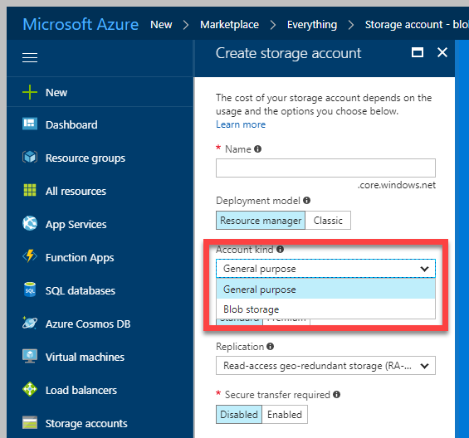
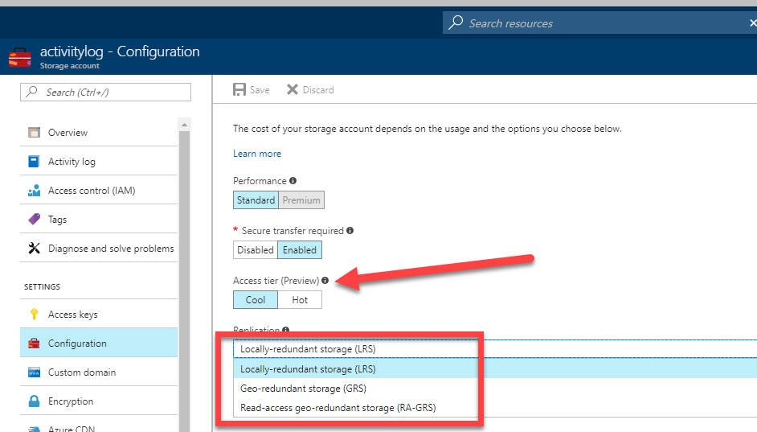
Azure Storage Account
Two Kinds of Storage Account
General Purpose Storage Account
Blobs
Files
Queues
Tables
VHD Disks(Page Blob)
Blob Storage Account
Block Blob
Append Blob
Page Blob
Performance Tier
General Purpose: Standard(HDD based), Premium(SSD based) for VM
Blob Account: Hot, Cool, Archival( Preview)

Slide 13
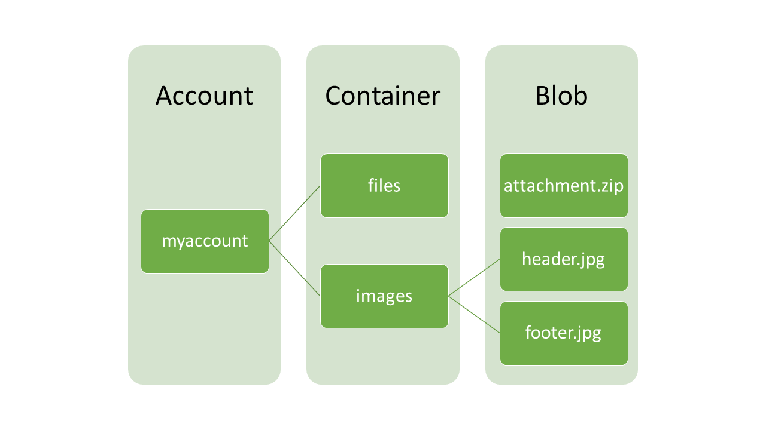
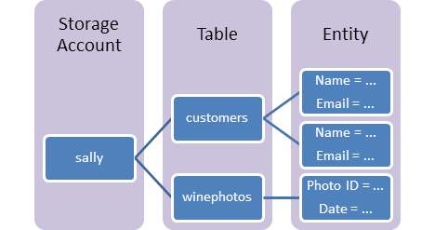
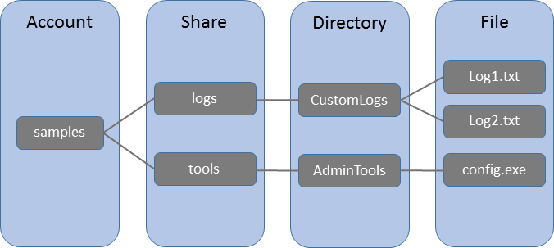
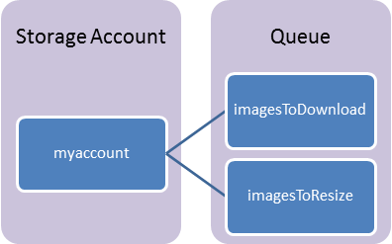
Azure Storage Account Schematic
Blob Storage
Azure Table
File Storage
Azure Queue

Slide 14
Azure Table Storage
Azure File Storage
Stores structure NoSQL
Key-value pair
Structured, non relational
Schemaless
Access data using the Odata & LINQ .
Quickly query data using a clustered index
Data is consistent for other client reads after insert/update
Fully managed file shares in the cloud
Supports SMB /CIFS protocol
Can be mounted concurrently
Azure File Sync(Preview)
Suitable for Lift & Shift
LRS, GRS replication

Slide 15
Azure Queue
Provides reliable, persistent messaging.
REST-based GET/PUT/PEEK
Maximum Message Size 64 KB. If larger message size needed use Service Bus
Maximum message TTL 7 days

Slide 16
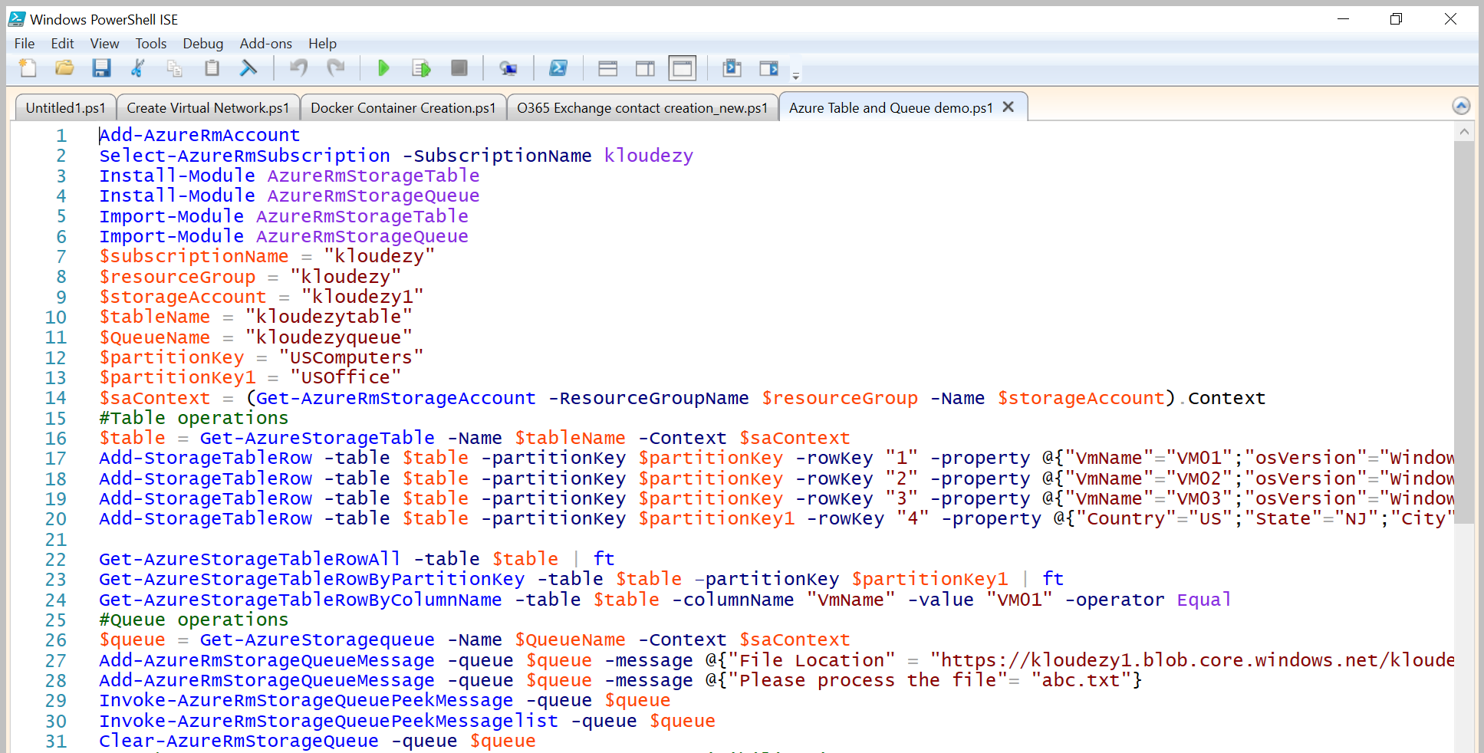
Table and Queue Storage via PowerShell

Slide 17
Storage Options
Standard
Max total request rate of 20k IOPS
Billed for actual usage*
Premium
Designed for Azure VMs
High performance
Low latency
Azure VM disks are implemented as “Page Blobs”
Billed for Provisioned space and not for actual usage.

Slide 18
Azure Blob Storage
Also called Object Storage
Storing large amounts of unstructured object data
Can be accessed from anywhere via HTTP or HTTPS
Three kinds of Blobs:
Block Blob
Append Blob
Page Blob
Common uses of Blob storage include:
Serving images or documents directly to a browser
Storing files for distributed access
Streaming video and audio
Storing data for backup and restore, disaster recovery, and archiving

Slide 19
Block Blobs
Blob is broken into pieces
Block Id for each piece
Max block size = 100MB
Up to 50k blocks per blob
The maximum size of a block blob is ~4.75 TB
Blocks upload can be multithreaded
Streaming , Storing documents, media files, backups

Slide 20
Append Blobs
Similar to Block Blobs
Optimized for append operations
Only can add to the end
The maximum size of an append blob is ~195 GB
Updating or deleting of existing blocks is not supported
Unlike a block blob, an append blob does not expose its block IDs.

Slide 21
Page Blob
Optimized for IaaS disks
Supports random read/writes
Collection of 512 byte pages
Max size = 8TB/4TB(VHD)
Storage Options
Premium Storage(SSD based)
Standard Storage(HDD based)

Slide 22
Replication for Table & Blob Storage
You can switch from LRS to GRS or RA-GRS but ZRS can’t be converted.
ZRS is only available for General Purpose Account type
Replication Option | Number of copies | Strategy
Locally redundant storage (LRS) | Maintains three copies of your data. | Data is replicated three time within a single facility in a single region.
Zone-redundant storage (ZRS) | Maintains three copies of your data. | Data is replicated three times across two to three facilities, either within a single region or across two regions.
Geo-redundant storage (GRS) | Maintains six copies of your data. | Data is replicated three times within the primary region, and is also replicated three times in a secondary region hundreds of miles away from the primary region.
Read access geo-redundant storage (RA-GRS) (Default) | Maintains six copies of your data. | Data is replicated to a secondary geographic location, and also provides read access to your data in the secondary location.

Slide 23
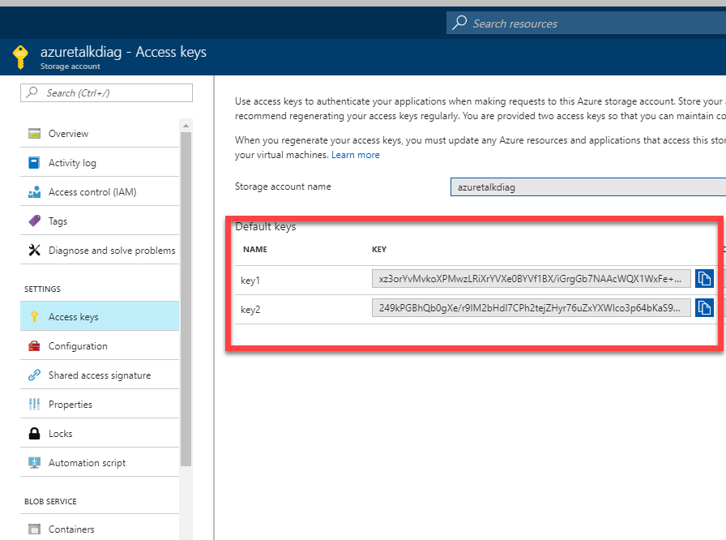
Blob Access
Anonymous Access: Public access for containers or individual blobs
Storage Access Key
Shared Access Signatures (SAS)
Delegated access without sharing account key
Containers & blobs
File shares & files
Queues
Tables & ranges of table entities

Slide 24
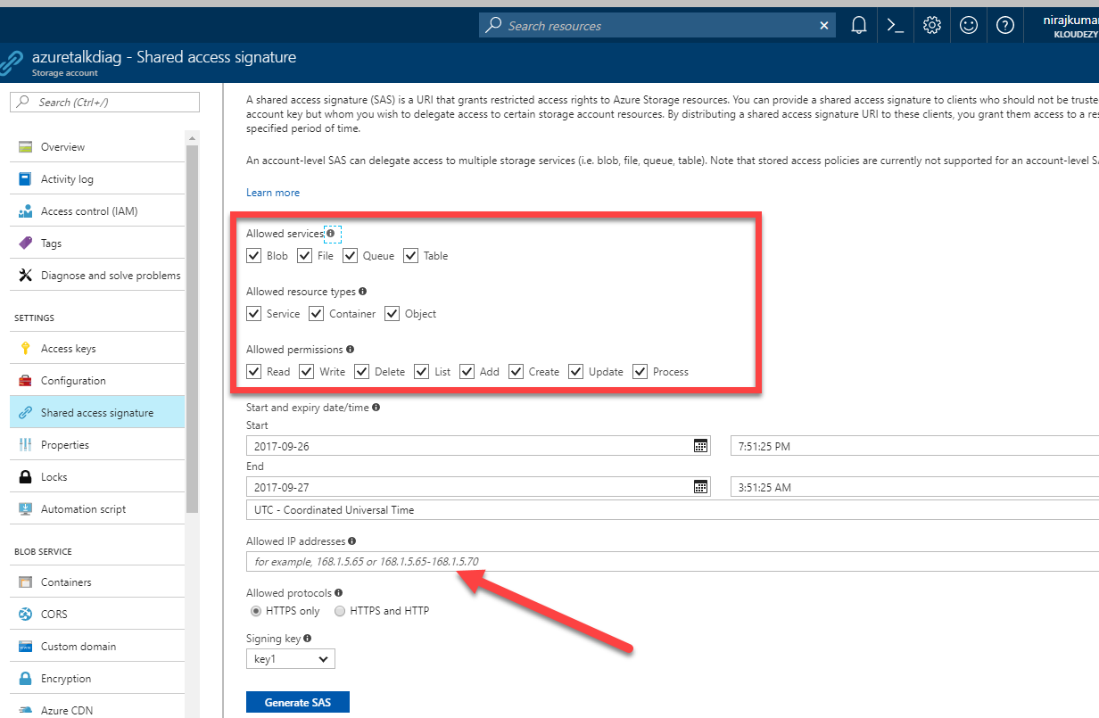
Shared Access Signatures (SAS)
Time interval
Start & end time for permissions
Permissions
Read, Write, and/or Delete
(Optional) IP address or address range
Allowed protocols
Example: only https

Slide 25
Azure Disk
Two ways to create VM disks
Unmanaged Disk
In an unmanaged disk, you manage the storage accounts
VHDs are stored in Page blob
99.99% SLA.
Can be converted to Managed.
Managed Disk
Azure manages the storage accounts that you use for your VM disks
Available in Standard & premium tier.
Standard can be converted in to Premium and vice-versa
99.999% SLA
Recommended storage for VMs.
Allow you to create up to 10,000 VM disks in a subscription
Billing for managed disks depends on the provisioned size of the disk.
Managed disk Overview

Slide 26
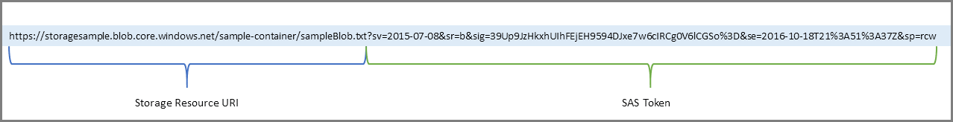
Example of SAS token
3.1.3 Exam Tip!

Slide 27
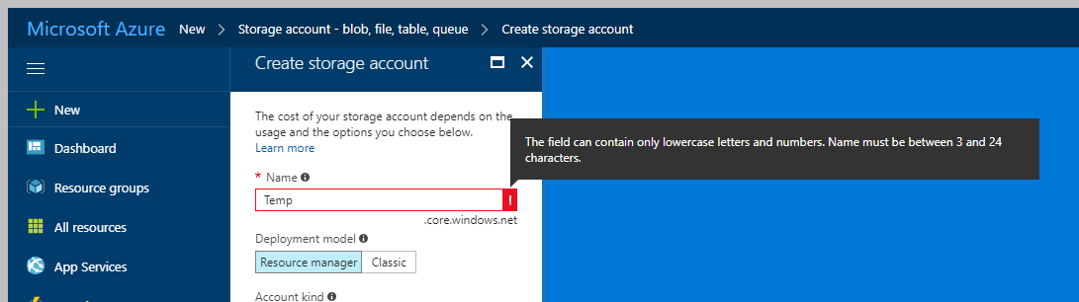
The storage account name should always in lowercase and unique within *.core.windows.net namespace.
3.1.4 Exam Tip!

Slide 28
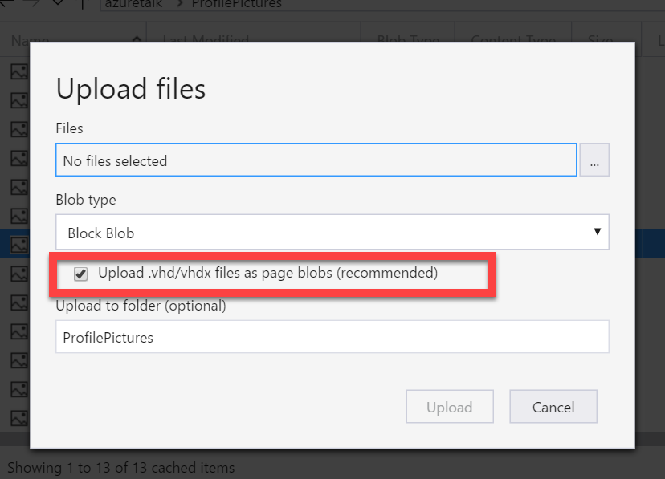
Choose appropriate blob type for uploading VHD. If VHD files are uploaded in block blob you can’t use those.
3.1.5 Exam Tip!

Slide 29
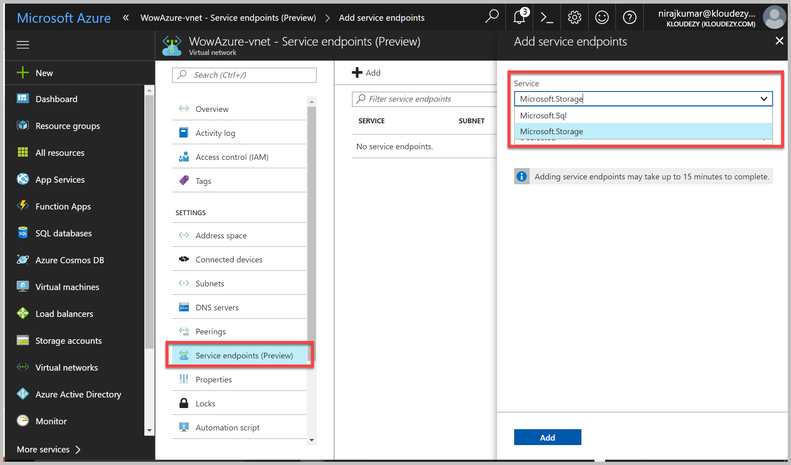
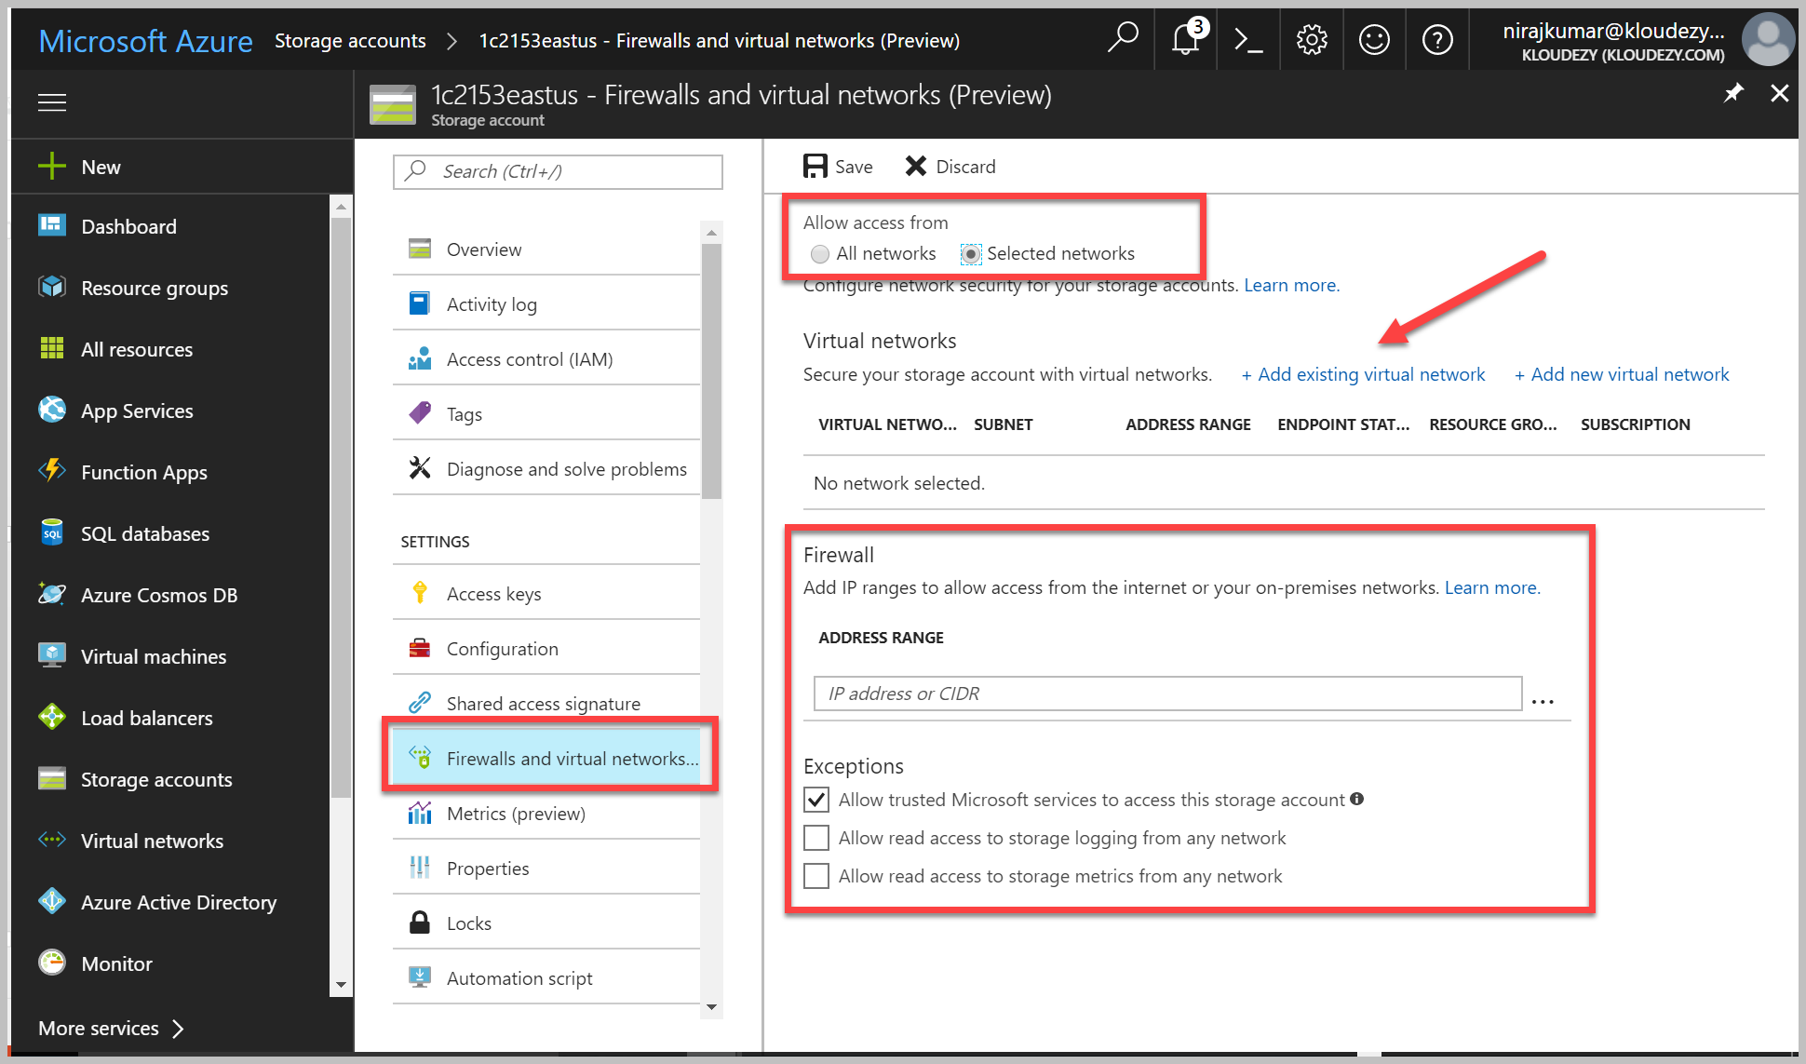
Blob Encryption/Security
Client-side
Storage Client Library for .NET
Server-side
“Data at Rest”
“Data in Transit”. Can be enforced.
Service Endpoints
Storage Firewall

Slide 30
Table & Blob: Performance, Storage Limits, etc.
https://docs.microsoft.com/en-us/azure/storage/storage-scalability-targets

Slide 31
Resource | Default Limit
Number of storage accounts per subscription | 200
TB per storage account | 500 TB
Max number of blob containers, blobs, file shares, tables, queues, entities, or messages per storage account | Only limit is the 500 TB storage account capacity
Max size of a single blob container, table, or queue | 500 TB
Max number of blocks in a block blob or append blob | 50,000
Max size of a block in a block blob | 100 MB
Max size of a block blob | 50,000 X 100 MB (approx. 4.75 TB)
Max size of a block in an append blob | 4 MB
Max size of an append blob | 50,000 X 4 MB (approx. 195 GB)
Max size of a page blob | 4 TB
Max size of a table entity | 1 MB

Slide 32
Resource | Default Limit
Maximum Request Rate per storage account | Blobs: 20,000 requests per second for blobs of any valid size (capped only by the account's ingress/egress limits)
 | Files: 1000 IOPS (8 KB in size) per file share
 | Queues: 20,000 messages per second (assuming 1 KB message size)
 | Tables: 20,000 transactions per second (assuming 1 KB entity size)
Target throughput for single blob | Up to 60 MB per second, or up to 500 requests per second
Target throughput for single queue (1 KB messages) | Up to 2000 messages per second
Target throughput for single table partition (1 KB entities) | Up to 2000 entities per second
Target throughput for single file share | Up to 60 MB per second
Max ingress per storage account (US Regions) | 10 Gbps if GRS/ZRS enabled, 20 Gbps for LRS
Max egress per storage account (US Regions) | 20 Gbps if RA-GRS/GRS/ZRS enabled, 30 Gbps for LRS
Max ingress per storage account (Non-US regions) | 5 Gbps if GRS/ZRS enabled, 10 Gbps for LRS
Max egress per storage account (Non-US regions) | 10 Gbps if RA-GRS/GRS/ZRS enabled, 15 Gbps for LRS

Slide 33
Sufficient bandwidth on VM
Make sure sufficient bandwidth is available on your VM to drive disk traffic, as described in Premium Storage-supported VMs. Otherwise, your disk throughput and IOPS is constrained to lower values. Maximum throughput and IOPS are based on the VM limits, not on the disk limits described in the preceding table.
https://docs.microsoft.com/en-us/azure/storage/storage-premium-storage#scalability-and-performance-targets

Slide 34
Premium storage accounts Scalability
… have the following scalability targets:+
Total account capacity | Total bandwidth Locally redundant storage account
Disk capacity: 35 TB Snapshot capacity: 10 TB | Up to 50 gigabits per second for inbound¹ + outbound² ¹ All data (requests) that are sent to a storage account+ ² All data (responses) that are received from a storage account
https://docs.microsoft.com/en-us/azure/storage/storage-premium-storage#scalability-and-performance-targets

Slide 35
If Using Storage Spaces Striping
If you stripe premium storage data disks by using Storage Spaces, set up Storage Spaces with 1 column for each disk that you use. Otherwise, overall performance of the striped volume might be lower than expected because of uneven distribution of traffic across the disks. By default, in Server Manager, you can set up columns for up to 8 disks. If you have more than 8 disks, use PowerShell to create the volume. Specify the number of columns manually. Otherwise, the Server Manager UI continues to use 8 columns, even if you have more disks. For example, if you have 32 disks in a single stripe set, specify 32 columns. To specify the number of columns the virtual disk uses, in the New-VirtualDisk PowerShell cmdlet, use the NumberOfColumns parameter. For more information, see Storage Spaces Overview and Storage Spaces FAQs.
https://docs.microsoft.com/en-us/azure/storage/storage-premium-storage#scalability-and-performance-targets

Slide 36
Pay Attention to I/O vs IOPs
If your disk traffic mostly consists of small I/O sizes, your application likely will hit the IOPS limit before the throughput limit. However, if the disk traffic mostly consists of large I/O sizes, your application likely will hit the throughput limit first, instead of the IOPS limit. You can maximize your application's IOPS and throughput capacity by using optimal I/O sizes. Also, you can limit the number of pending I/O requests for a disk.
https://docs.microsoft.com/en-us/azure/storage/storage-premium-storage#scalability-and-performance-targets

Slide 37
Azure Storage Samples
https://azure.microsoft.com/en-us/resources/samples/?service=storage

Slide 38
Table Labs for .NET
https://github.com/Azure-Samples/storage-table-dotnet-getting-started

Slide 39
Blob Labs for .NET
https://azure.microsoft.com/en-us/resources/samples/storage-blob-dotnet-getting-started/
https://github.com/Azure-Samples/storage-blob-dotnet-getting-started

Slide 40
SAS Labs
https://azure.microsoft.com/en-us/resources/samples/storage-dotnet-sas-getting-started/

Slide 41
Azure Storage KeyWords
General Purpose account
Blob Account
Premium
Standard
SSE ( Server Side Encryption)
Hot, Cool, Archive
Block, Append, Page blob
Azure File, Queue, Table, blob
SAS(Shared Access Signature)
Storage Key
Containers
Entity
Message
Managed Disk
IOPs
LRS, ZRS, GRS, RA-GRS
Storage Explorer
Azcopy

Slide 42
SQL Database

Slide 43
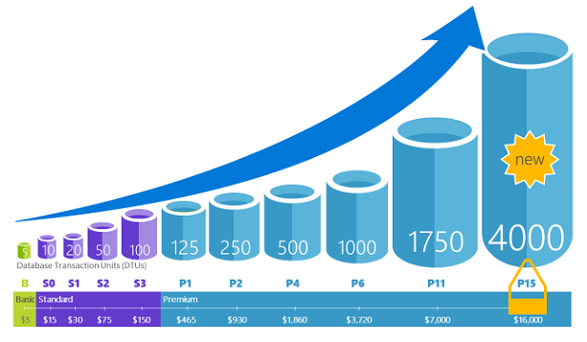
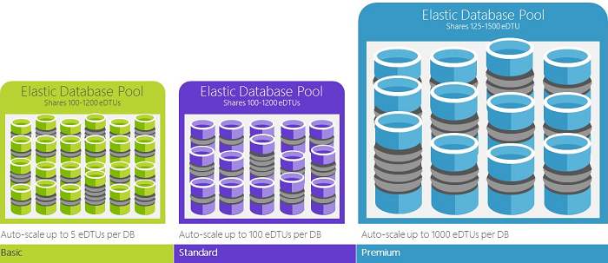
Azure SQL Database
PaaS Offering. Database-as-a-Service
Relational database.
Service tiers:
Basic
Standard
Premium
Premium RS
Elastic Pools. Pooled databases delivers performance
Source: Microsoft

Slide 44
Service Tiers
Basic
Small size
Low traffic
Single active operation
Standard
Low to medium IO performance requirements
Multiple current queries
Premium
High transaction volume
High IO performance requirements
Many concurrent users
High availability
For mission critical apps
Premium RS
IO-intensive apps
Does not require high availability
Analytical workloads

Slide 45
Service Tier Attributes
Service tier features | Basic | Standard | Premium | Premium RS
Maximum single database size | 2 GB | 250 GB | 4 TB* | 1 TB
Maximum elastic pool size | 156 GB | 4 TB | 4 TB* | 1 TB
Maximum database size in an elastic pool | 2 GB | 250 GB | 500 GB | 500 GB
Maximum number of databases per pool | 500 | 500 | 100 | 100
Maximum single database DTUs | 5 | 100 | 4000 | 1000
Maximum DTUs per database in an elastic pool | 5 | 3000 | 4000 | 1000
Database backup retention period | 7 days | 35 days | 35 days | 35 days
SKUs | Basic | S0-S12 | P1-P6, P11, P15 | PRS1, PRS2, PRS4, PRS6
https://docs.microsoft.com/en-us/azure/sql-database/sql-database-service-tiers

Slide 46
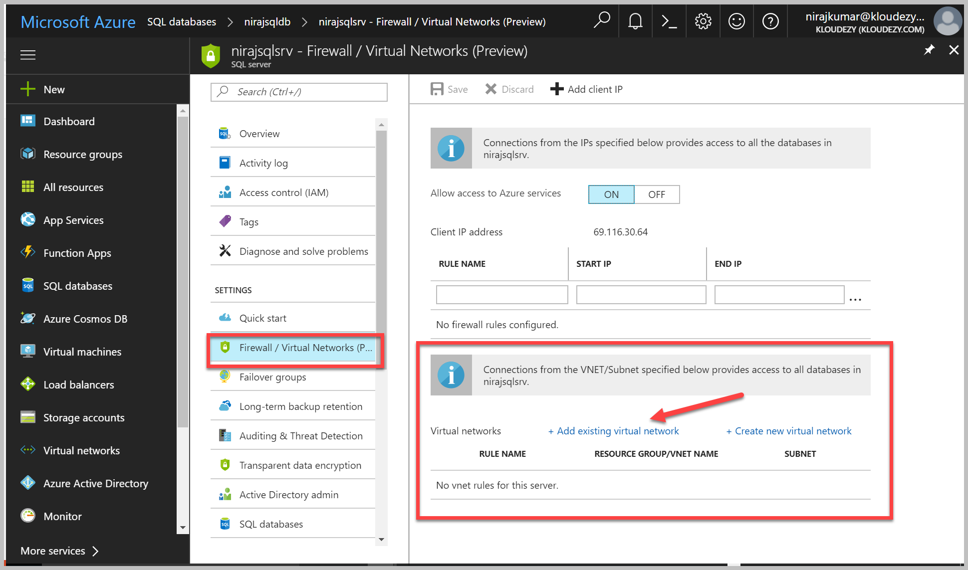
SQL Database Security
Firewall & Firewall Rules
Service Endpoints
Auditing for compliance and security
Encryption
TDE( Now supports BYOK, in public Preview)
Always Encrypt
Authentication: “Who are you?”
SQL Authentication
Azure Active Directory (AAD) Authentication (supports Federated identities and MFA)
Authorization
“What can you do?”
Dynamic data masking: Hide sensitive data from non-privileged users
Row-level security

Slide 47
Azure SQL KeyWords
TDE
SQL Firewall
DTU(Database Transaction Unit)
eDTU(Elastic DTU)
Always Encrypt
Azure AD integrated Authentication
Dynamic data masking
Long term backup retention
Row Level Security
Failover Groups
Audit and threat detection
Active directory admin
Elastic pool
Geo Replication
Vulnerability Assessment
Data Sync

Slide 48
SQL Database Videos
https://azure.microsoft.com/en-us/resources/videos/index/?services=sql-database

Slide 49
CosmosDB

Slide 50
Cosmos DB
Azure Cosmos DB is a globally distributed database service
“one of the supported APIs and data models”
Document != *.docx
Document == JSON
NoSQL, Schema free database
99.99% availability within a single region.
It is a good choice for new web, mobile, gaming, and IoT applications
HIPAA-compliant
PaaS

Slide 51
DocumentDB Programming Options
Server-side programming options
Stored procs, triggers, & user-defined functions
Written in JavaScript
https://docs.microsoft.com/en-us/azure/cosmos-db/programming

Slide 52
DocumentDB Resources
Stored Proc Programming Video
https://docs.microsoft.com/en-us/azure/cosmos-db/programming
DocumentDB vs MongoDB
https://medium.com/@th0maswe1ss/azure-documentdb-vs-mongodb-6d5806c16239
Getting Started
https://docs.microsoft.com/en-us/azure/cosmos-db/documentdb-get-started

Slide 53
Azure CosmosDb KeyWords
Request Unit(RU)
Key-Value Pair
No SQL
Schema less
ARS (atoms, records and sequences)
Master Key
PreferredLocations
Collection
Connection String
Indexing Policy
Partition Key
Row Key

Slide 54
MySQL

Slide 55
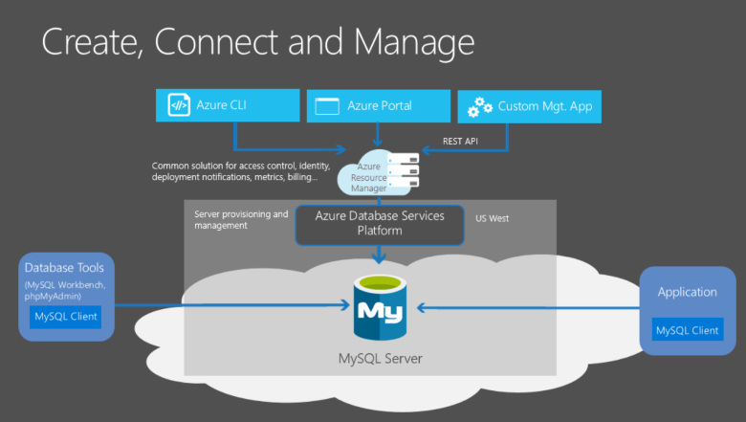
MySQL
Relational database
~3 Azure Options
Run it in a IaaS VM
Hosted by ClearDb
Azure Database for MySQL
Based on the MySQL Community Edition database engine
Dynamic scalability with no application downtime.
Built-in high availability.
https://azure.microsoft.com/en-us/services/mysql/
Source: Microsoft

Slide 56
MySQL Resources
https://docs.microsoft.com/en-us/azure/mysql/

Slide 57
MongoDB

Slide 58
MongoDB
“humongous"
NoSQL
JSON-like(Binary JSON) documents with schemas
Two options:
One of the offerings under Cosmos DB
Install on VM
MongoDB’s support upto 16MB.
MongoDB is free to use from a software licensing perspective
https://docs.microsoft.com/en-us/azure/virtual-machines/windows/classic/install-mongodb

Slide 59
3.1.1 Exam Tip!
Know the various storage types and their uses. For example, many times you can use Queues to decouple components of a system.

Slide 60
3.1.1: A title company needs to provide access to storage for people to upload scans of documents that they signed. There are time limits to when the documents are needed. Which approach should be used to provide access?
Create a service and set up the valid dates in a database that will be read
Use an SAS and set the expiration time and date for the user.
Set up Azure AD with permissions for the user that limit the time in which she can upload documents.
Open up the Blob storage container to public access so that the user can add the document even if she is late.

Slide 61
3.1.3: A company is looking to move its existing system from on-premises to Azure and it is using MySQL. Which of the following are valid statements?
MySQL is not a Microsoft product, so it cannot be used in Azure.
MySQL can be set up in its own VM.
Convert all of the data to SQL Azure to save time and money.
There is a MySQL option in the Azure Marketplace.

Slide 62
3.1.2
Azure might update to change feature availability. The exam is updated over time, as well, to reflect these changes. However, because of the way Azure is steadily being updated, the newest features might not be on the exams.

Slide 63
3.1.3
Performance levels of the database are important to a company, and the ability to change this at times is equally important. For example, the limits of each level of SQL Database can help the architect to determine the minimum level needed to satisfy those needs.

Slide 64
New Azure Service updates (Storage)
Public preview: Virtual network service endpoints for Azure Storage and SQL Database
Announcing Preview of Azure Storage Firewalls and Virtual Networks
Announcing larger, higher scale storage accounts
Announcing the public preview of Azure Archive Blob Storage and Blob-Level Tiering
Instant File Recovery from Azure VM backups is now generally available
"Secure transfer required" is available in Azure Storage account
Announcing large disk sizes of up to 4 TB for Azure IaaS VMs
Announcing Storage Service Encryption for Azure Managed Disks
Announcing Storage Service Encryption with Customer Managed Keys limited preview
Announcing general availability of Storage Service Encryption for Azure File Storage
Source: https://azure.microsoft.com/en-us/blog/

Slide 65
New Azure Service updates (Database)
Put your databases on autopilot with a lift and shift to Azure SQL Database
Announcing Azure Database for MySQL Public Preview
New performance levels and storage add-ons in Azure SQL Database
Preview: SQL Transparent Data Encryption (TDE) with Bring Your Own Key support
Default compatibility level 140 for Azure SQL databases
Azure AD authentication extensions for Azure SQL DB and SQL DW tools
Database Scoped Global Temporary Tables in public preview for Azure SQL DB
Resumable Online Index Rebuild is in public preview for Azure SQL DB
In-Memory OLTP Update
Dear DocumentDB customers, welcome to Azure Cosmos DB!
Azure SQL Database now supports transparent geographic failover of database groups
Source: https://azure.microsoft.com/en-us/blog/

Slide 66
Videos
Mark Grimes @ MSFT
Certification Exam Overview 70-534
https://mva.microsoft.com/en-US/training-courses/certification-exam-overview-70534-architecting-microsoft-azure-solutions-17406

Slide 67
Summary
Table storage supports structured data that uses a partition key and a row key for searches.
Blob storage supports unstructured data files such as text or binary data (document files, pictures, whatever).
DocumentDB is a NoSQL, JSON document–based storage system that by default has every field indexed.
MongoDB and MySQL databases are supported through the Azure Marketplace.
Copyright MICROSOFT Not for public disclosure

